Slide 1



Fastag Fraud Detection

Slide 2



TABLE OF
Contents
01
Introduction
02
Data Exploration
03
Data Preprocessing
04
Model Training
05
Model Evaluation
06
Feature Importance
07
Real-Time Fraud Detection using Flask

Slide 3

Introduction
Objective:
Detect and prevent fraudulent transactions within the Fastag system data.
Enhance security and reliability of electronic toll collection.
Data Source:
FastagFraudDetection.csv dataset containing transactional data related to Fastag usage.
Tools and Technologies:
Python: Programming language used for data manipulation, preprocessing, and modeling.
Scikit-learn: Machine learning library in Python for building predictive models.
Pandas: Python library for data manipulation and analysis.
Jupyter Notebook (Colab): Interactive environment for Python programming and data analysis.
RandomForestClassifier: Ensemble learning method used for classification tasks, chosen for its ability to handle complex data and feature interactions.

Slide 4
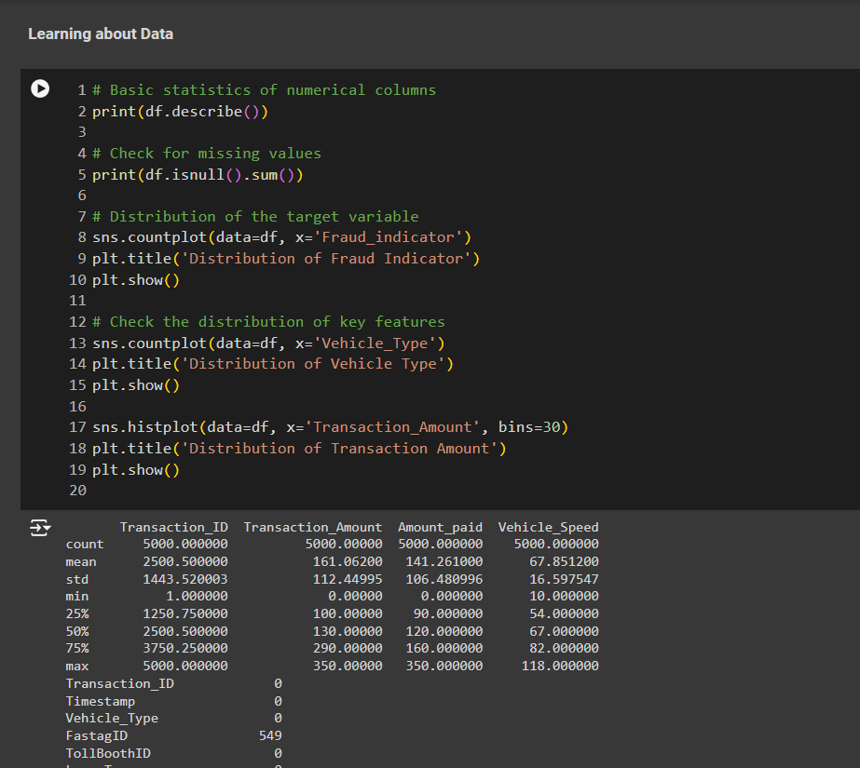

Data Exploration
Overview:
Perform initial exploration of the dataset to understand its structure and characteristics.
Insights:
Statistical Summary of Numerical Features:
Review key statistics such as mean, median, min, max, and quartiles for features like Transaction Amount, Amount Paid, and others.
Distribution of Target Variable (Fraud Indicator):
Visualize the distribution of the target variable 'Fraud Indicator' using a countplot to understand class balance (fraudulent vs. non-fraudulent transactions).
Distribution of Critical Features:
Explore distributions of critical categorical features such as Vehicle Type and numerical features like Transaction Amount.
Utilize countplots and histograms to visualize these distributions and identify any patterns or outliers.

Slide 5
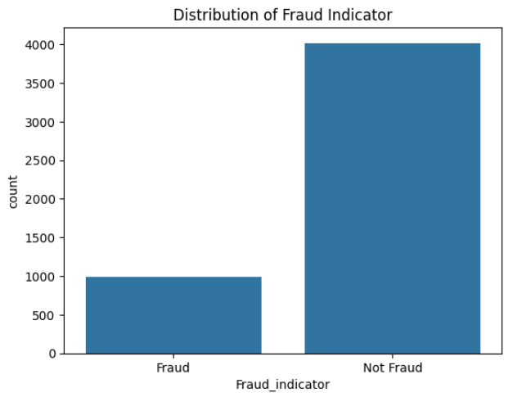
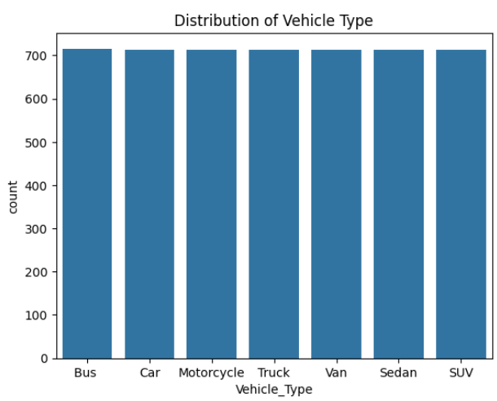
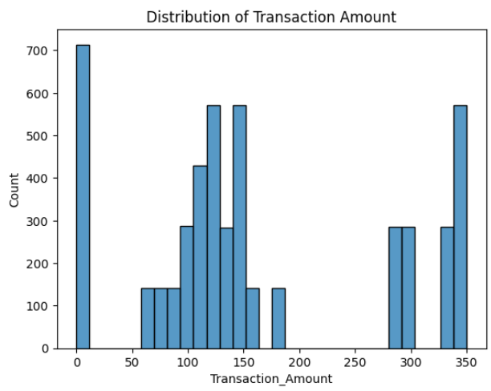
Data Exploration

Slide 6
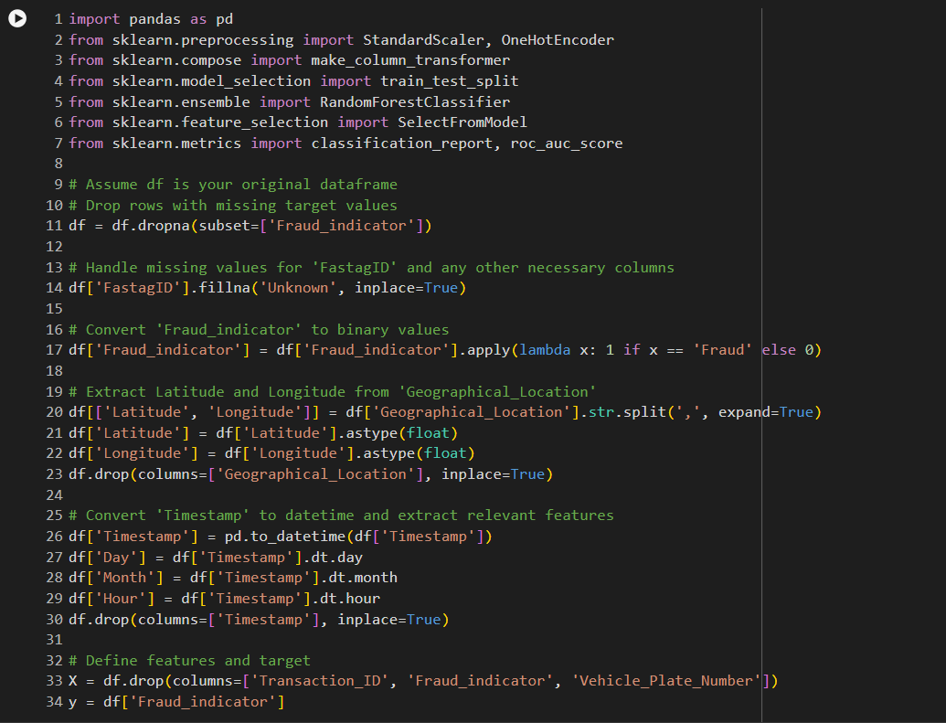
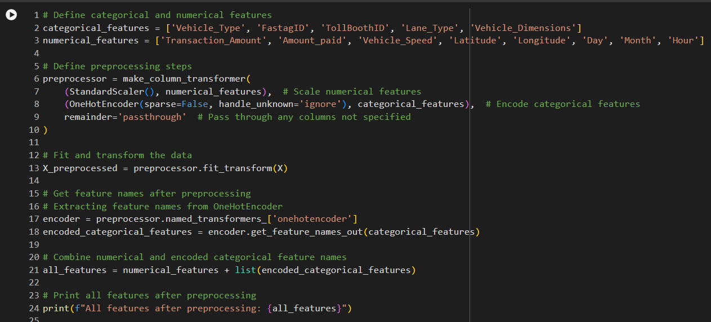
Data Preprocessing
Handling Missing Data:
Drop rows with missing target values (Fraud Indicator) to ensure data integrity.
Fill missing values in 'FastagID' with 'Unknown' or appropriate method to maintain completeness.
Feature Engineering:
Extract Latitude and Longitude from 'Geographical_Location' to enhance spatial analysis.
Derive 'Day', 'Month', and 'Hour' features from 'Timestamp' to capture temporal patterns in transactions.
Encoding:
Utilize OneHotEncoder to convert categorical variables into numerical representations suitable for machine learning models.
Ensure categorical features like 'Vehicle Type' and 'Lane Type' are encoded appropriately for model compatibility.

Slide 7
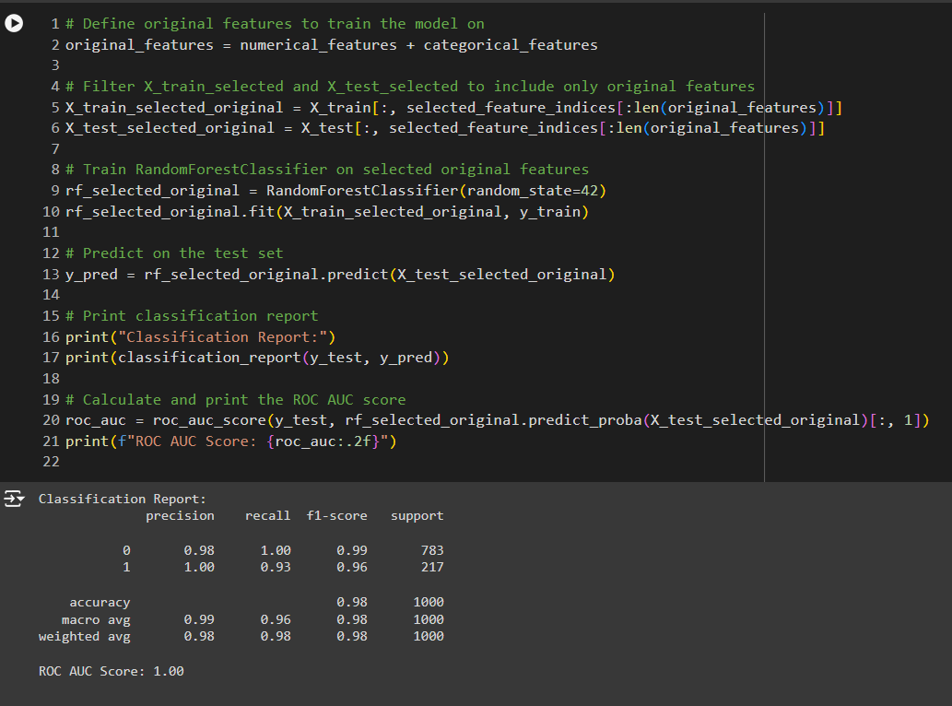
Model Training
Model: RandomForestClassifier
Ensemble learning method that fits multiple decision tree classifiers on various sub-samples of the dataset and uses averaging to improve predictive accuracy and control over-fitting.
Training Process:
Split Data: Divide the preprocessed data into training and test sets (e.g., 80% for training, 20% for testing) using train_test_split function from sklearn.model_selection.
Fit RandomForestClassifier: Train the RandomForestClassifier on the selected features derived from the preprocessing stage. This includes numerical features (scaled) and encoded categorical features.
Evaluate Model Performance:
Use classification_report to generate a comprehensive report of precision, recall, F1-score, and support for each class (fraudulent and non-fraudulent).
Calculate the ROC AUC score to measure the model's ability to distinguish between classes and assess overall performance.

Slide 8
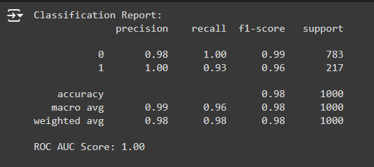

Model Evaluation
Performance Metrics:
Classification Report: Provides detailed evaluation metrics including Precision, Recall, F1-score, and Support for each class (fraudulent and non-fraudulent).
Precision: Proportion of correctly predicted positive cases among all predicted positive cases.
Recall: Proportion of correctly predicted positive cases among all actual positive cases.
F1-score: Harmonic mean of precision and recall, providing a balanced measure.
ROC AUC Score: Measures the model's ability to distinguish between classes. Represents the area under the Receiver Operating Characteristic (ROC) curve.
Higher ROC AUC score (closer to 1) indicates better model performance in distinguishing between fraudulent and non-fraudulent transactions.

Slide 9
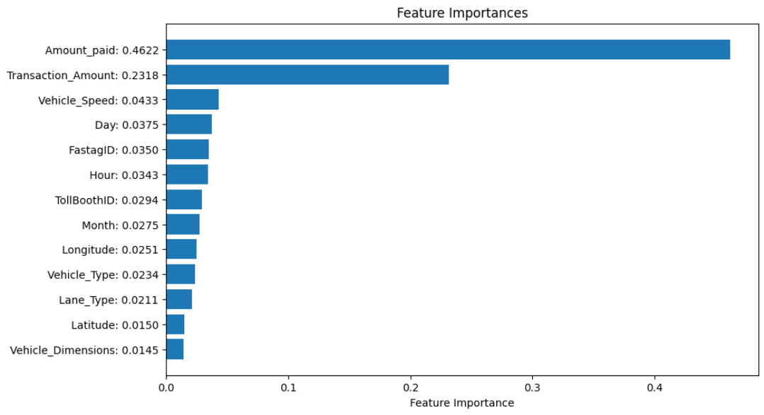

Feature Importance
Insights:
Display Feature Importances Graphically:
Utilize a horizontal bar chart to visually represent feature importances.
Feature importances are derived from the RandomForestClassifier model and indicate the relative importance of each feature in making predictions.
Highlight Key Features Driving Predictions:
Identify and emphasize the top features contributing most significantly to the model's predictions.
Feature importance ranking helps prioritize which features are most influential in determining whether a transaction is fraudulent or not.

Slide 10
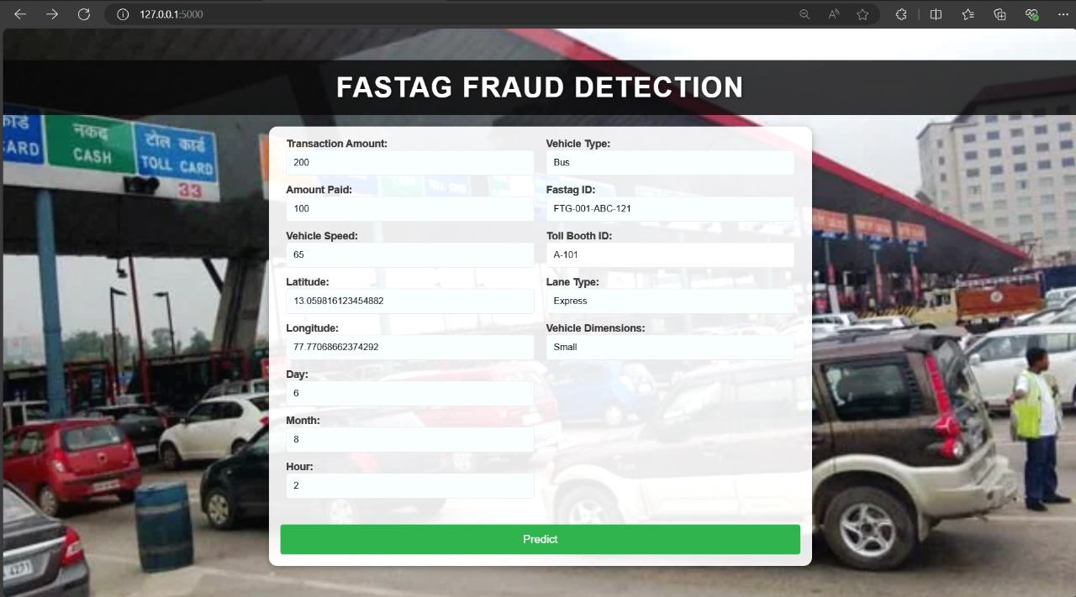
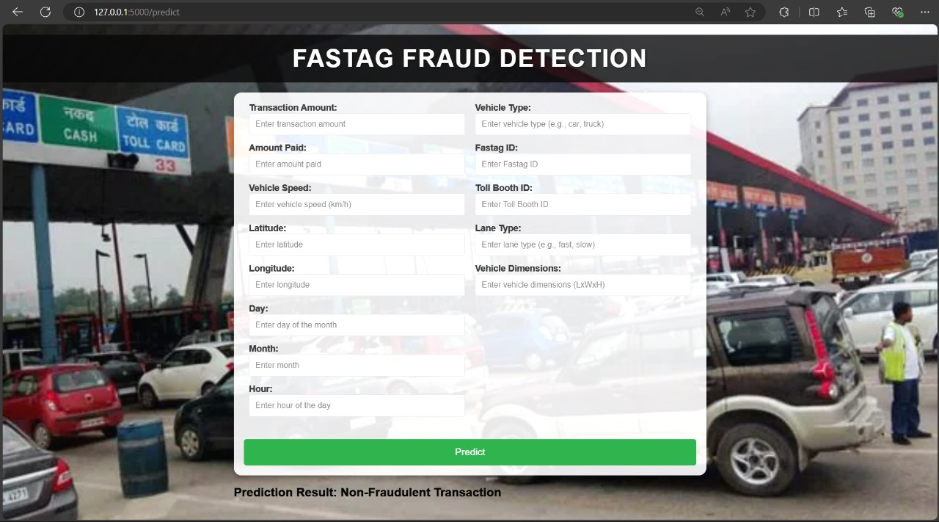
Real-Time Fraud Detection using Flask

Slide 11

Conclusion
Key Takeaways:
Successfully Trained a RandomForestClassifier: Developed and trained a RandomForestClassifier model to detect fraudulent transactions in the Fastag system data. Achieved effective classification performance as evidenced by evaluation metrics.
Importance of Feature Engineering and Selection: Highlighted the critical role of feature engineering (e.g., extracting spatial and temporal features) in enhancing model performance. Feature selection ensured focusing on the most relevant features, optimizing model accuracy and efficiency.
Future Enhancements and Scalability: Consider future enhancements such as integrating real-time data for continuous model improvement. Evaluate scalability options to handle increasing data volumes and transaction complexity.

Slide 12


